Slide 1
Chapter 10.7
Planar Graphs
These class notes are based on material from our textbook, Discrete Mathematics and Its Applications, 7th ed., by Kenneth H. Rosen, published by McGraw Hill, Boston, MA, 2011. They are intended for classroom use only and are not a substitute for reading the textbook.

Slide 2
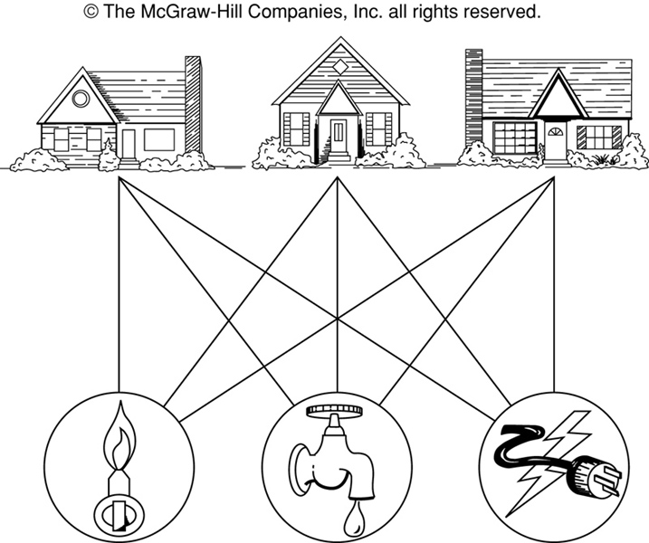
The House-and-Utilities Problem

Slide 3
Planar Graphs
Consider the previous slide. Is it possible to join the three houses to the three utilities in such a way that none of the connections cross?

Slide 4
Planar Graphs
Phrased another way, this question is equivalent to: Given the complete bipartite graph K_{3,3}, can K_{3,3} be drawn in the plane so that no two of its edges cross?
K_{3,3}

Slide 5
Planar Graphs
A graph is called planar if it can be drawn in the plane without any edges crossing.
A crossing of edges is the intersection of the lines or arcs representing them at a point other than their common endpoint.
Such a drawing is called a planar representation of the graph.

Slide 6
Example
A graph may be planar even if it is usually drawn with crossings, since it may be possible to draw it in another way without crossings.

Slide 7
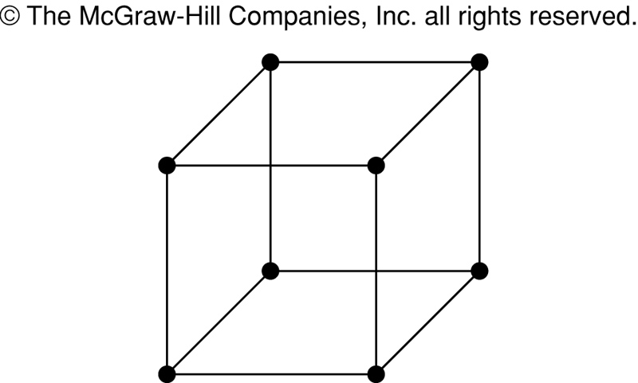
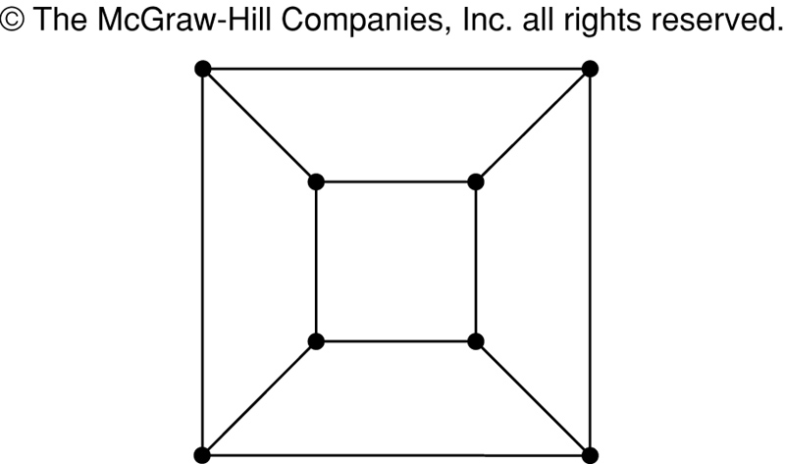
Example
A graph may be planar even if it represents a 3-dimensional object.

Slide 8
Planar Graphs
We can prove that a particular graph is planar by showing how it can be drawn without any crossings.
However, not all graphs are planar.
It may be difficult to show that a graph is nonplanar. We would have to show that there is no way to draw the graph without any edges crossing.

Slide 9
Regions
Euler showed that all planar representations of a graph split the plane into the same number of regions, including an unbounded region.
R₄ R₃ R₂
R₁

Slide 10
Regions
In any planar representation of K_{3,3}, vertex v₁ must be connected to both v₄ and v₅, and v₂ also must be connected to both v₄ and v₅.
v₁ v₂ v₃
v₄ v₅ v₆

Slide 11
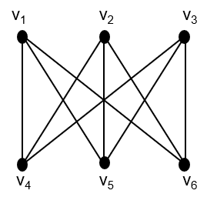
Regions
The four edges {v₁, v₄}, {v₄, v₂}, {v₂, v₅}, {v₅, v₁} form a closed curve that splits the plane into two regions, R₁ and R₂.
v₁ v₅
R₂ R₁
v₄ v₂

Slide 12
Regions
Next, we note that v₃ must be in either R₁ or R₂.
Assume v₃ is in R₂. Then the edges {v₃, v₄} and {v₄, v₅} separate R₂ into two subregions, R₂₁ and R₂₂.
v₁ v₅ v₁ v₅
R₂₁
R₂ R₁ → v₃
R₂₂
v₄ v₂ v₄ v₂

Slide 13
Regions
Now there is no way to place vertex v₆ without forcing a crossing:
If v₆ is in R₁ then {v₆, v₃} must cross an edge
If v₆ is in R₂₁ then {v₆, v₂} must cross an edge
If v₆ is in R₂₂ then {v₆, v₁} must cross an edge
v₁ v₅
R₂₁
v₃ R₁
R₂₂
v₄ v₂

Slide 14
Regions
Alternatively, assume v₃ is in R₁. Then the edges {v₃, v₄} and {v₄, v₅} separate R₁ into two subregions, R₁₁ and R₁₂.
v₁ v₅
R₁₁
R₂ R₁₂ v₃
v₄ v₂

Slide 15
Regions
Now there is no way to place vertex v₆ without forcing a crossing:
If v₆ is in R₂ then {v₆, v₃} must cross an edge
If v₆ is in R₁₁ then {v₆, v₂} must cross an edge
If v₆ is in R₁₂ then {v₆, v₁} must cross an edge
v₁ v₅
R₁₁
R₂ R₁₂ v₃
v₄ v₂

Slide 16
Planar Graphs
Consequently, the graph K_{3,3} must be nonplanar.
K_{3,3}

Slide 17
Regions
Euler devised a formula for expressing the relationship between the number of vertices, edges, and regions of a planar graph.
These may help us determine if a graph can be planar or not.

Slide 18
Euler’s Formula
Let G be a connected planar simple graph with e edges and v vertices. Let r be the number of regions in a planar representation of G. Then r = e - v + 2.
R₄ R₃ R₂
R₁
# of edges, e = 6
# of vertices, v = 4
# of regions, r = e - v + 2 = 4

Slide 19
Euler’s Formula (Cont.)
Corollary 1: If G is a connected planar simple graph with e edges and v vertices where v ≥ 3, then e ≤ 3v - 6.
Is K₅ planar?
K₅

Slide 20
Euler’s Formula (Cont.)
K₅ has 5 vertices and 10 edges.
We see that v ≥ 3.
So, if K₅ is planar, it must be true that e ≤ 3v – 6.
3v – 6 = 3*5 – 6 = 15 – 6 = 9.
So e must be ≤ 9.
But e = 10.
So, K₅ is nonplanar.
K₅

Slide 21
Euler’s Formula (Cont.)
Corollary 2: If G is a connected planar simple graph, then G must have a vertex of degree not exceeding 5.
If G has one or two vertices, it is true;
thus, we assume that G has at least three vertices.
If the degree of each vertex were at least 6, then by Handshaking Theorem,
2e ≥ 6v, i.e., e ≥ 3v,
but this contradicts the inequality from
Corollary 1: e ≤ 3v – 6.

Slide 22
Euler’s Formula (Cont.)
Corollary 3: If a connected planar simple graph has e edges and v vertices with v ≥ 3 and no circuits of length 3, then e ≤ 2v - 4.
Is K_{3,3} planar?

Slide 23
Euler’s Formula (Cont.)
K_{3,3} has 6 vertices and 9 edges.
Obviously, v ≥ 3 and there are no circuits of length 3.
If K_{3,3} were planar, then e ≤ 2v – 4 would have to be true.
2v – 4 = 2*6 – 4 = 8
So e must be ≤ 8.
But e = 9.
So K_{3,3} is nonplanar.
K_{3,3}

Slide 24

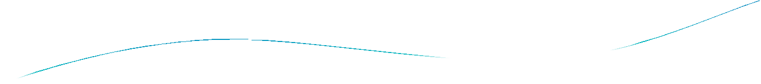



Chapter 11

Slide 25

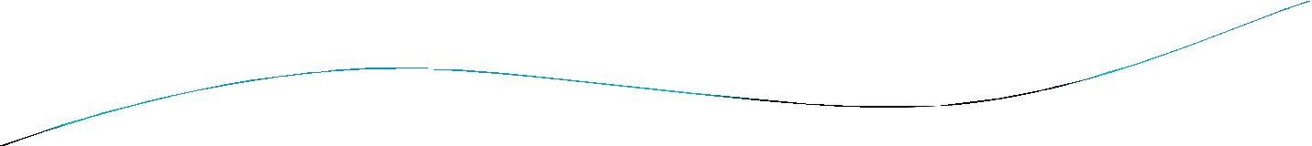
Chapter Summary
Introduction to Trees
Applications of Trees
Tree Traversal
Spanning Trees
Minimum Spanning

Slide 26
Section 11.1

Slide 27

Section Summary
Introduction to Trees
Rooted Trees
Trees as Models
Properties of Trees

Slide 28

Trees
Definition: A tree is a connected undirected graph with no simple circuits.
Definition: An undirected graph is a tree if and only if there is a unique simple path between any two of its vertices. A tree cannot contain multiple edges or loops.
Definition: An undirected graph is a tree if and only if there is a unique simple path between any two of its vertices.

Slide 29

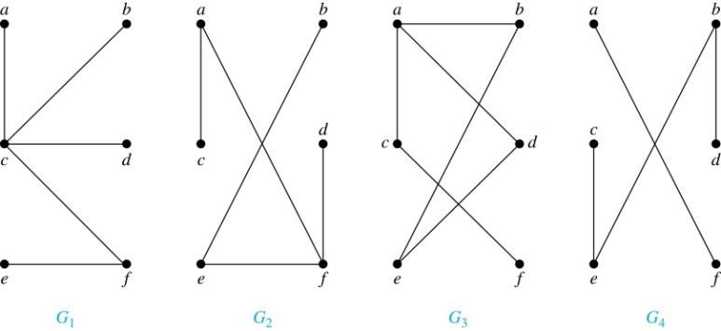
Trees
Example: Which of these graphs are trees?
Solution: G₁ and G₂ are trees - both are connected and have no simple circuits. G₃ is not a tree because e, b, a, d, e is a simple circuit,. G₄ is not a tree because it is not connected.

Slide 30

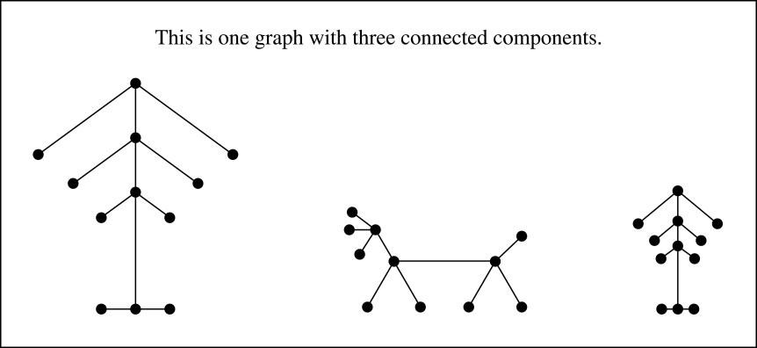
FOREST
Definition: A forest is a graph that has no simple circuit, but is not connected. Each of the connected components in a forest is a tree.

Slide 31

Section 11.2

Slide 32

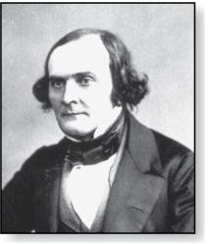
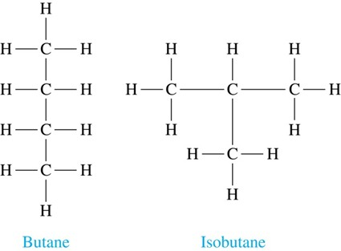
Trees as Models
Arthur Cayley (1821-1895)
Trees are used as models in computer science, chemistry, geology, botany, psychology, and many other areas.
Trees were introduced by the mathematician Cayley in 1857 in his work counting the number of isomers of saturated hydrocarbons. The two isomers of butane are:.

Slide 33

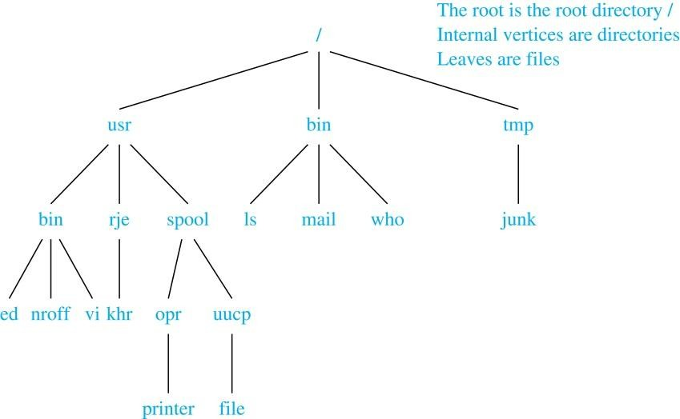
Trees as Models
The organization of a computer file system into directories,
subdirectories, and files is naturally represented as a tree.

Slide 34

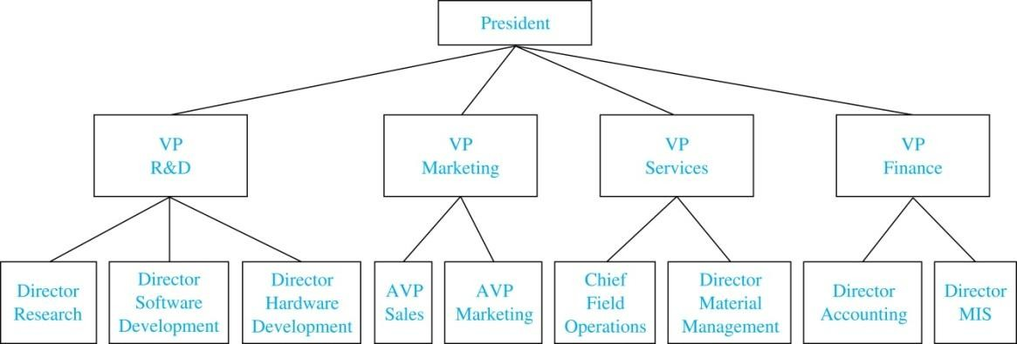
Trees as Models
Trees are used to represent the structure of organizations.

Slide 35

Applications of Trees
Game Trees
Trees can be used to analyze certain types of games such as tic-tac-toe, nim, checkers, and chess.

Slide 36

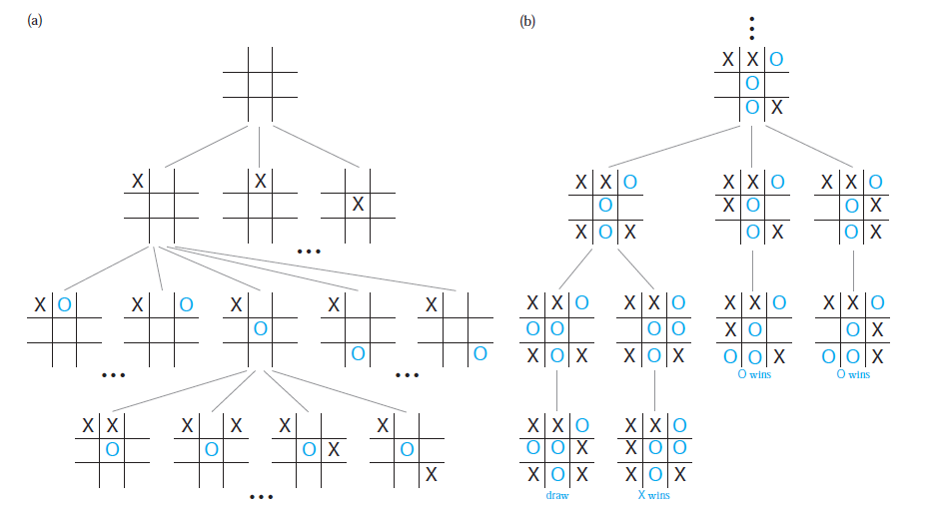
Game Tree for Tic-Tac-Toe

Slide 37

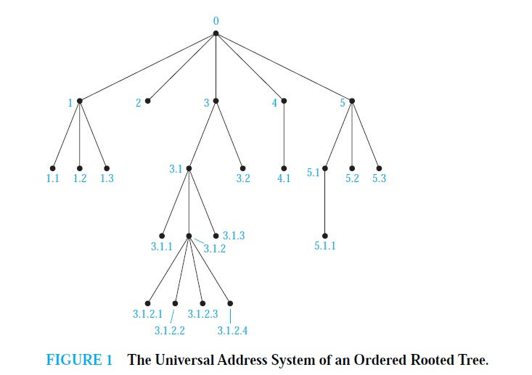
Universal Address Systems

Slide 38

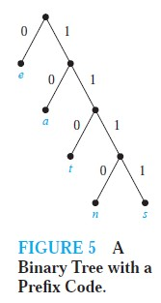
Prefix code
Definition: A code that has the property that the code of a character is never a prefix of the code of another character.
A prefix code can be represented using a binary tree, where the characters are the labels of the leaves in the tree.
The edges of the tree are labeled so that an edge leading to a left child is assigned a 0 and an edge leading to a right child is assigned a 1.
The bit string used to encode a character is the sequence of labels of the edges in the unique path from the root to the leaf that has this character as its label.
For instance, the tree in Figure 5 represents the encoding of e by 0, a by 10, t by 110, n by 1110, and s by 1111.

Slide 39

Decision Trees
Definition: A rooted tree where each vertex represents a possible outcome of a decision and the leaves represent the possible solutions of a problem.
Rooted trees can be used to model problems in which a
series of decisions leads to a solution.
The possible solutions of the problem correspond to the paths to the leaves of this rooted tree.

Slide 40

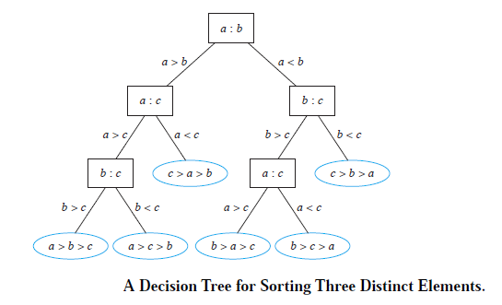
Example : A decision tree that orders the elements of the list a, b, c.

